Slide 1
Achieve Your Best Lesson 20: Pacing Answers

Slide 2
An expression is shown below:
For which value of x should the expression be further simplified?
11
14
17
18

Slide 3
2. A hockey team offers box seats for $37 each and regular seats for $16 each. The team presold 153 box seats and 68 regular seats. Which is closest estimate of how much the team made in presales?
$5,900
$7,400
$10,400
$13,200

Slide 4
3. A salesman earns a base salary of $2,000 plus $150 for each sale he makes. Last month he earned $5,750. Which equation could be used to find s, the number of sales he made last month?

Slide 5
4. When the expression
is factored completely, which is one its factors?

Slide 6
5. At a football game, Jerry purchased x hotdogs and y drinks. He spent a total of $22. The equation below represents the relationship between the number of hotdogs and drinks purchased.
The ordered pair represents the solution of the equation. What does the solution represent?
Hotdogs cost $3 and drinks cost $2.
Jerry purchased 3 hotdogs and 2 drinks.
Jerry spent $3 on hotdogs and $2 on drinks.
Jerry purchased 2 drinks and 3 hotdogs.

Slide 7
6. Which of the following inequalities is true for all real values of x?

Slide 8
Which of the following sets of ordered pairs is not a function?
{(1,2), (2,3), (3,4), (4,5)}
{(1,4), (3,7), (1,2), (8,5)}
{(3,2), (4,6), (7,2), (1,8)}
{(2,3), (3,2), (5,6), (6,5)}

Slide 9
8. A pizza shop charges for pizzas and adds a delivery fee. The cost (c), in dollars, to have any number of pizzas (p) delivered to a home is described by the function c=14p+3. Which statement is true?
The cost of 14 pizzas $17.
The cost of 3 pizzas is $17.
Each pizza costs $14 and the delivery fee is $3.
Each pizza costs $3 and the delivery fee is $14.

Slide 10
9. A bakery sells cakes. The amount charged for a cake (c) is $20 plus an additional charge for each color (d) used to decorate the cake, as shown in the equation below.
What does the number 3 represent in the equation?
The cost of an undecorated cake.
The number of colors used on the cake.
The additional cost for each color used on the cake.
The cost of the cake decorated with one color.

Slide 11
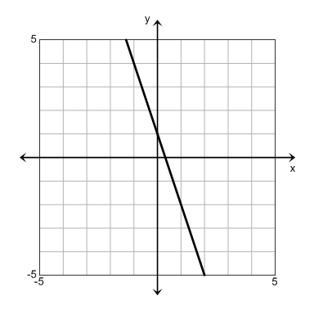
10. A graph of a linear equation is shown below. Which equation describes the graph?

Slide 12
11. A student’s SAT scores are listed below.
1080 1125 1170 1215 1260
The scores follow a pattern. Which expression can be used to determine the student’s scores after n attempts?
45n + 1080
45(n + 1080)
1080n + 45
1080n

Slide 13
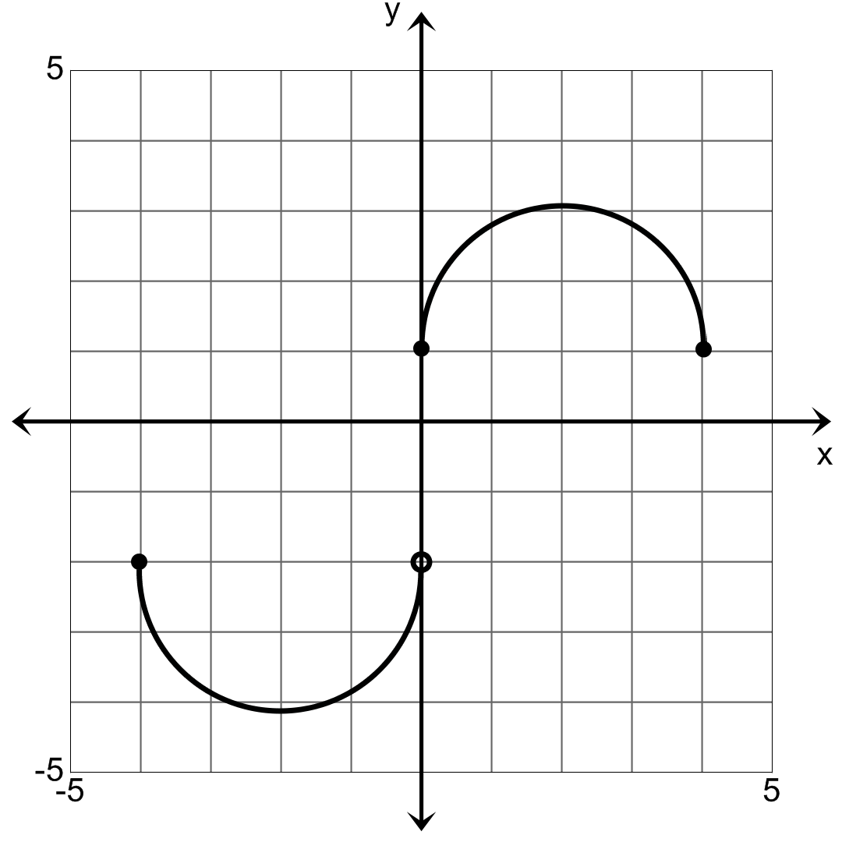
12. Which value is not in the range of the function?
-4
0
1
2

Slide 14
13. The table below shows values of y as a function of x.
Which linear equation best describes the relationship between x and y?
x | y
0 | -3
1 | -1
2 | 1
3 | 3

Slide 15
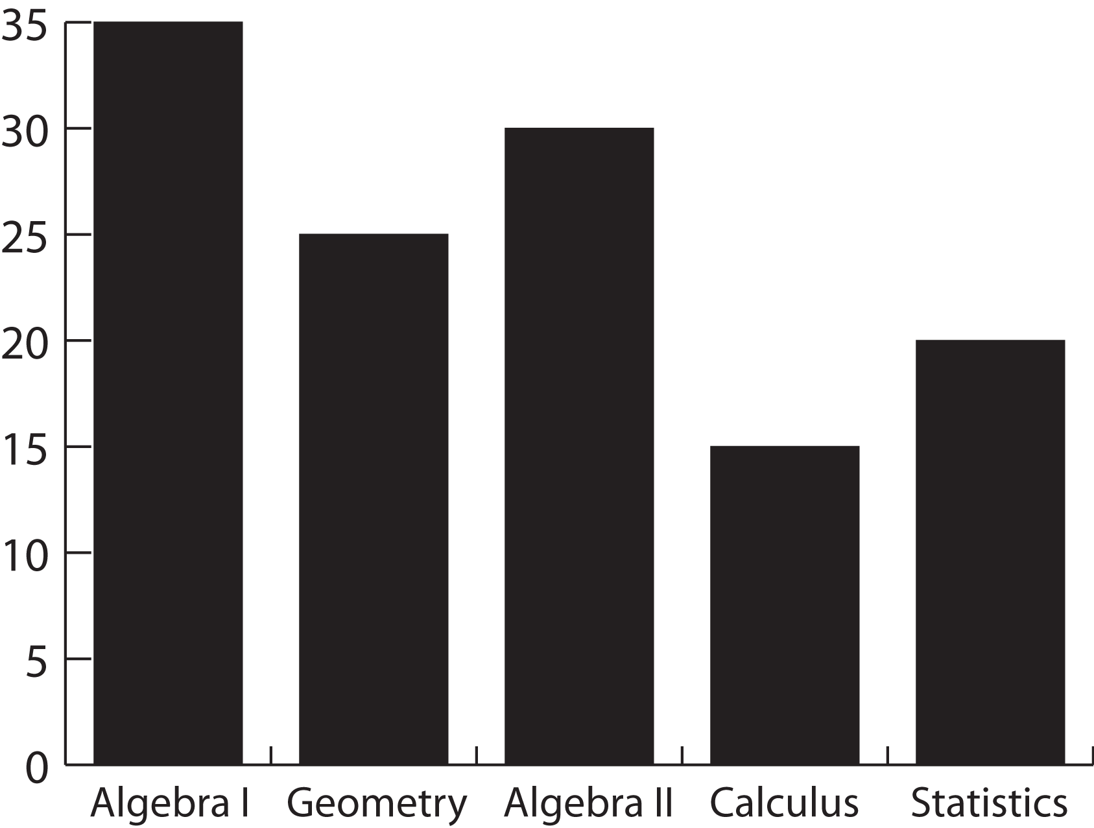
14. The bar graph below represents students’ favorite math classes. How many more students prefer Statistics over Calculus?
5
10
15
20

Slide 16
15. The box-and-whisker plot below represents the raw scores on an Algebra test.
Which of the following statements is true?
Approximately 25% of the scores are between 3 and 10.5
Approximately 25% of the scores are between 7 and 18
Approximately 50% of the scores are between 7 and 18.
Approximately 50% of the scores are between 3 and 7.

Slide 17
16. Two dice are thrown and the sum of the sides calculated. What is the probability that the sum of the sides is 6?
6%
14%
17%
50%

Slide 18
17. Two monomials are shown below.
What is the least common multiple (LCM) of these monomials?

Slide 19
18. The length of each edge of a cube is tripled. By what factor is the volume of the cube increased?
3
6
9
27

Slide 20
19. Which value is closest to the square root of 280?
16.7
140
560
78,400

Slide 21
20. The ordered pairs below represent a function.
{(1,4), (2,7), (5,3), (9,8)}
What is the domain of the function?
{4, 7, 3, 8}
{(4,1), (7,2), (3,5), (8,9)}
{1, 2, 5, 9}
{5, 9, 8, 17}

